Slide 1
DEEP FAKE
Detection
ABHIJITH T S
C0PSCS2102
Guided by Mrs. LISHA A

Slide 2
Table of contents
Introduction
Problem statement
Objectives
Motivation
Existing methods
Design
Implementation steps
Methodology
Result and analysis
Conclusion
References

Slide 3
Introduction
Deep fake is a technique for human image synthesis based on artificial intelligence
Deep fakes are created by combing and superimposing existing images and videos onto source images or videos using a deep learning technique known as generative adversarial network.
Deepfake detection system allow computers to identify these kind of fake media

Slide 4
Problem statement
To Design and Develop a Deep Learning algorithm to classify the video as deepfake or pristine.

Slide 5
Objectives
The main objective of this system is to predict the media novelty
Current deepfake generation systems are so accurate that human naked I can’t detect a fake video
The system must be able to detect these media with high confidence rate

Slide 6
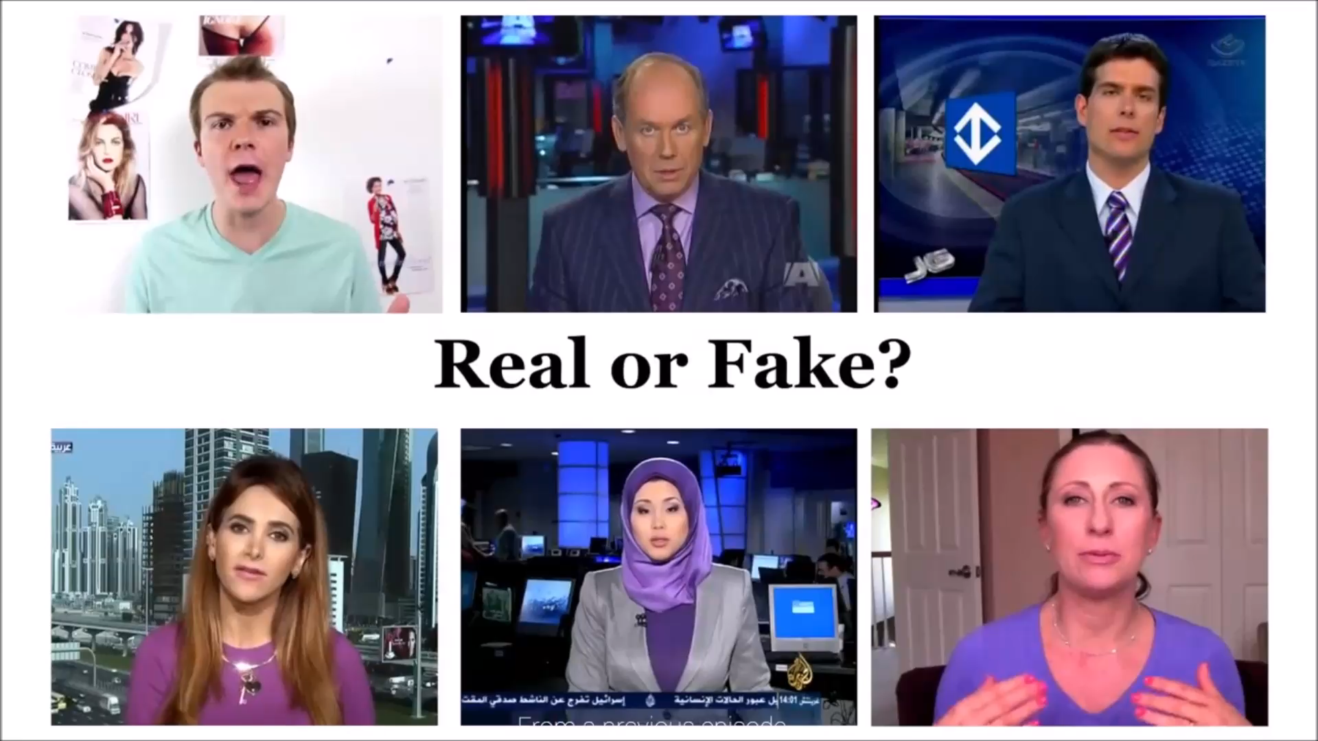
Motivation

Slide 7
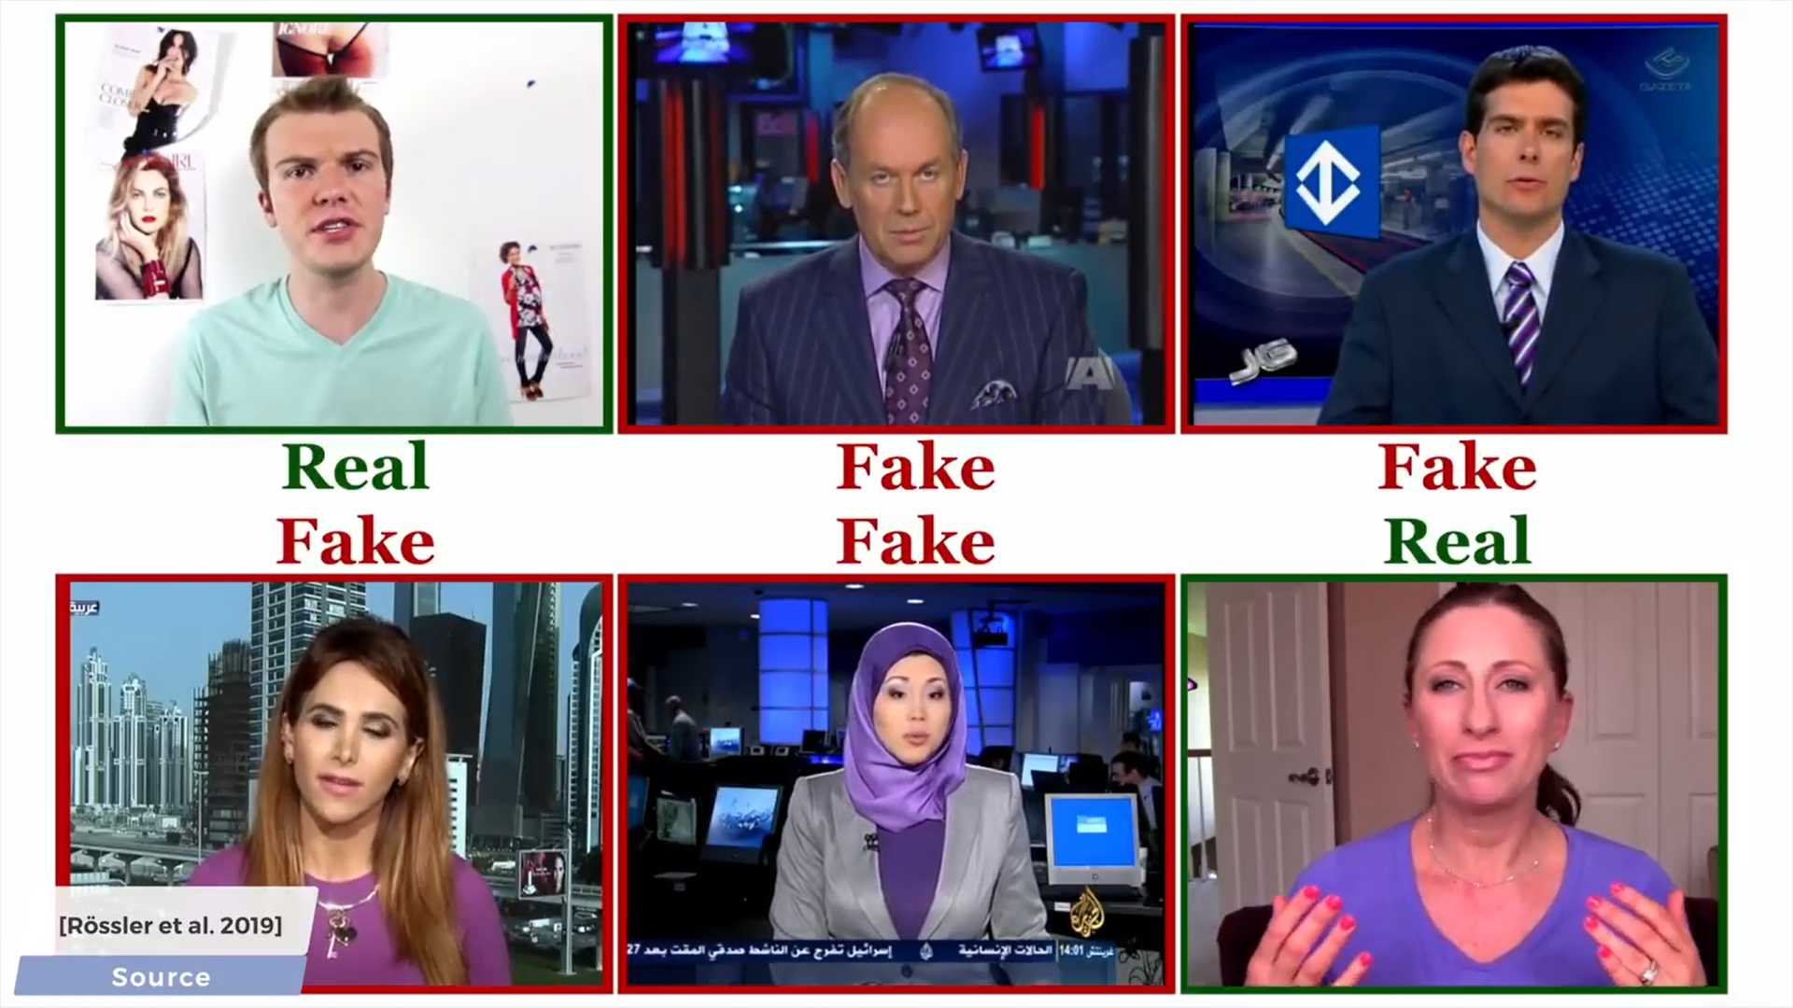

Slide 8
Existing methods
Detection using eye blinking
[1]Yuezun Li presented a new approach based on natural network to detect Fake Face Videos. Compared with the previous work, this method considers eye blinking to detect fake videos, which is an important physical feature that can be used to distinguish the fake videos.
analyzing the “heartbeat” of deep fakes.
[2]Ciftci et al.for example has designed a Generative Adversarial Network (GAN) based model that can detect the deepfake video source by analyzing the “heartbeat” of deep fakes. The proposed model starts by having several detector networks where the input to this model is the real video.

Slide 9
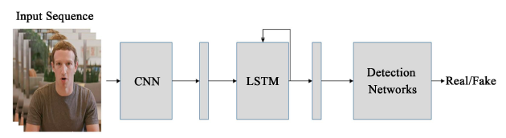
Design
The design implements a CNN for features extraction and a LSTM network for prediction [3][4]

Slide 10
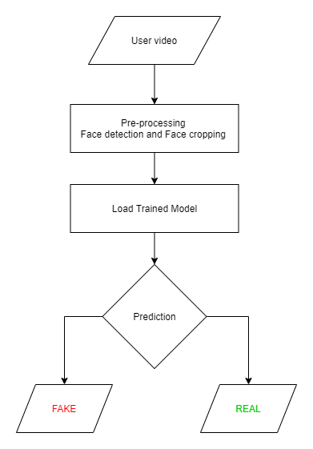

Slide 11
Implementation steps
Download dataset
Preprocessing dataset and corresponding labels
Loading the data and train the models
Plotting test accuracy
Uploading video file for prediction
Getting classification result with confidence rate

Slide 12
Methodology
Dataset used
The primary data set used was provided by Kaggle[5] which contain 400 GB of data, selected 400 train videos and 400 test videos
Algorithms used
A CNN called resnext50 which is used to extract features from each frames. Then this data is fed in to a LSTM for prediction

Slide 13
Libraries used
Pytorch is an open source machine learning (ML) framework based on the Python programming language and the Torch library. It is one of the preferred platforms for deep learning research. The framework is built to speed up the process between research prototyping and deployment.
Face Recognition
. Recognize and manipulate faces from Python or from the command line with the world’s simplest face recognition library

Slide 14
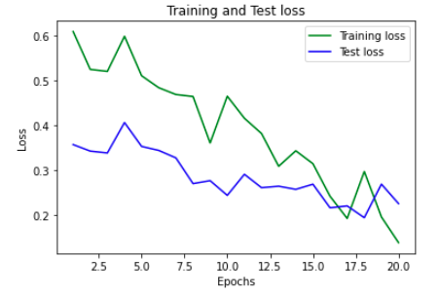
Result and analysis
Plots

Slide 15
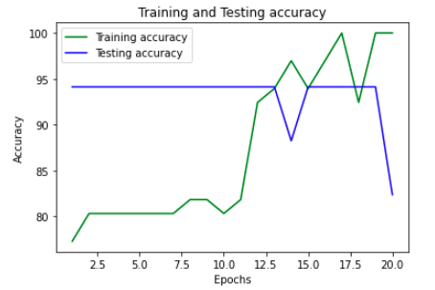

Slide 16
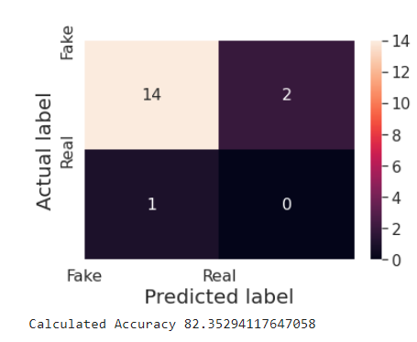
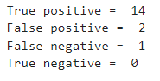

Slide 17
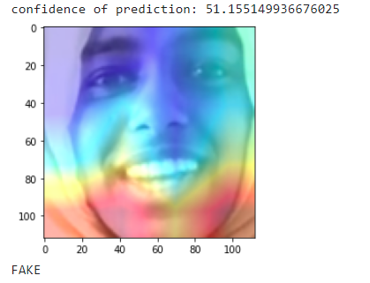

Predictions

Slide 18
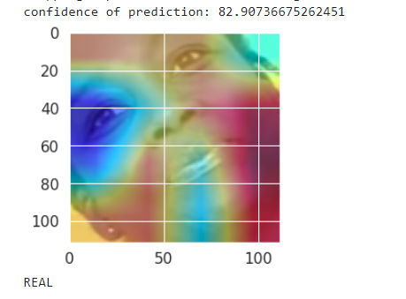


Slide 19
Conclusion
The implemented algorithms were able to predict real and fake videos correctly.
Got an average accuracy of 82 %
Day by day deepfakes are improving thus we need to train the model for new fakes and improve it’s accuracy

Slide 20
References
[1] Li, Y., Chang, M.-C. and Lyu, S. (2018) In Ictu Oculi: Exposing AI Generated FakeFace Videos by Detecting Eye Blinking. 2018 IEEE International Workshop on Information Forensics and Security (WIFS), Hong Kong, 11-13 December 2018, 1-7. https://doi.org/10.1109/WIFS.2018.8630787
[2] Ciftci, U.A., Demir, I. and Yin, L. (2020) How Do the Hearts of Deep Fakes Beat? Deep Fake Source Detection via Interpreting Residuals with Biological Signals. 2020 IEEE International Joint Conference on Biometrics (IJCB), Houston, 28 September- 1 October 2020, 1-10. https://doi.org/10.1109/IJCB48548.2020.9304909
[3] Güera, D. and Delp, E.J. (2018) Deepfake Video Detection Using Recurrent Neural Networks. 2018 15th IEEE International Conference on Advanced Video and Signal Based Surveillance (AVSS), Auckland, 27-30 November 2018, 1-6. https://doi.org/10.1109/AVSS.2018.8639163
[4] How to cite this paper: Almars, A.M. (2021) Deepfakes Detection Techniques Using Deep Learning: A Survey. Journal of Computer and Communications , 9, 20-35. https://doi.org/10.4236/jcc.2021.95003 College of Computer Science and Engineering, Taibah University, Yanbu, Saudi Arabia
[5] https://www.kaggle.com/competitions/deepfake-detection-challenge/data

Slide 21
THAK YOU

